Slide 1
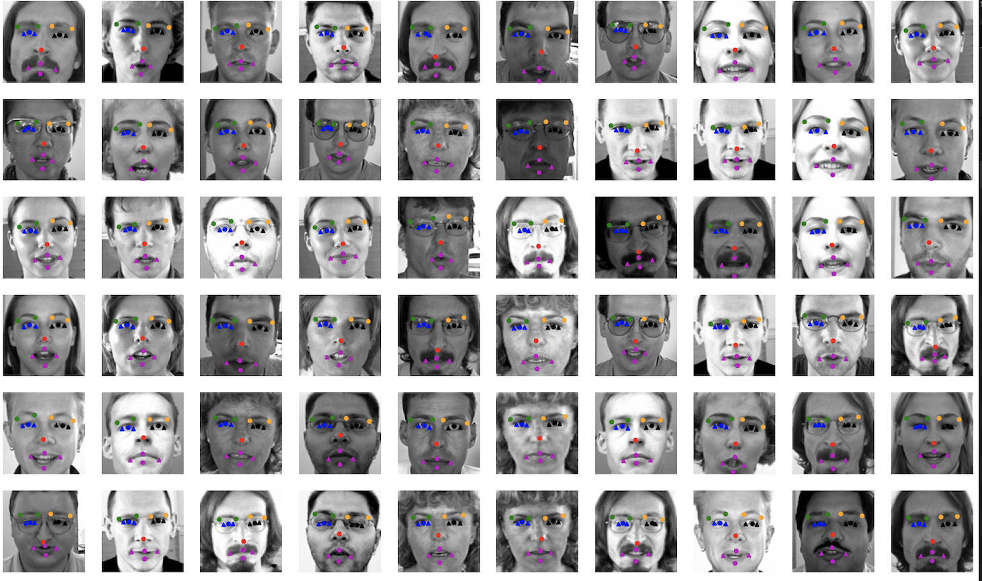
Facial Keypoints Detection
Alan Zhang, Haoyu Zhang,
Sam Temlock, Whit Blodgett

Slide 2
Agenda
Overview & EDA
Baseline Model
Data Augmentation
Performance & Challenge
Lessons we learned

Slide 3
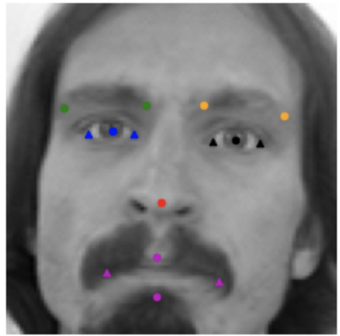
Overview
Train data size: 7049
Grayscale image size: (96, 96, 1)
15 key points- 15 Elements of the face
Each key point is specified by an (x,y) pair in the space of pixel indices
Notes:
All images 1 channel greyscale

Slide 4
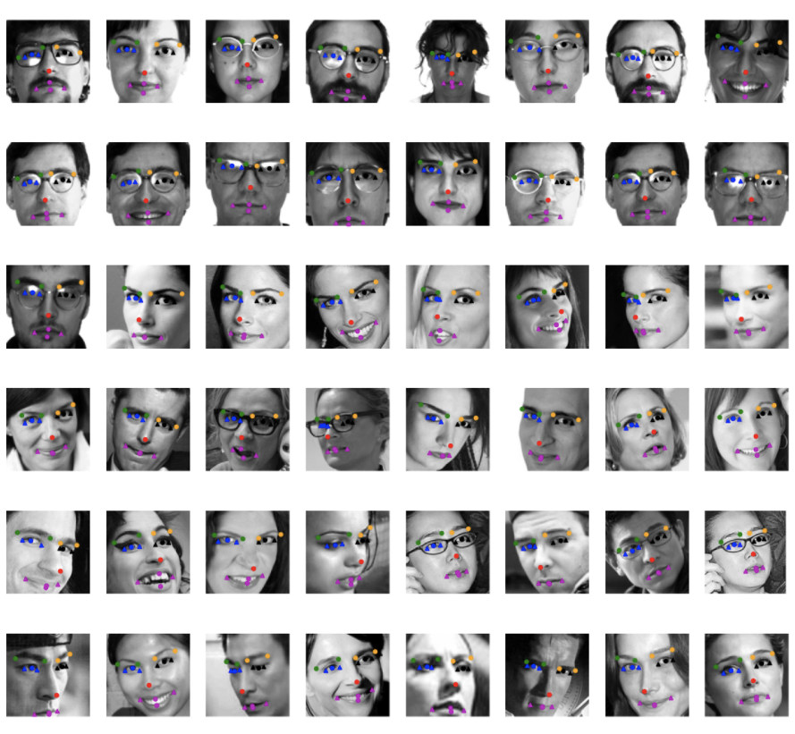
EDA
Drop any image with missing facial keypoint labels
2140 samples left
Notes:
Found that using the CV2 package for augmentation was actual less performant in our cases than writing our own functions from scratch (rotation, contrast especially)

Slide 5
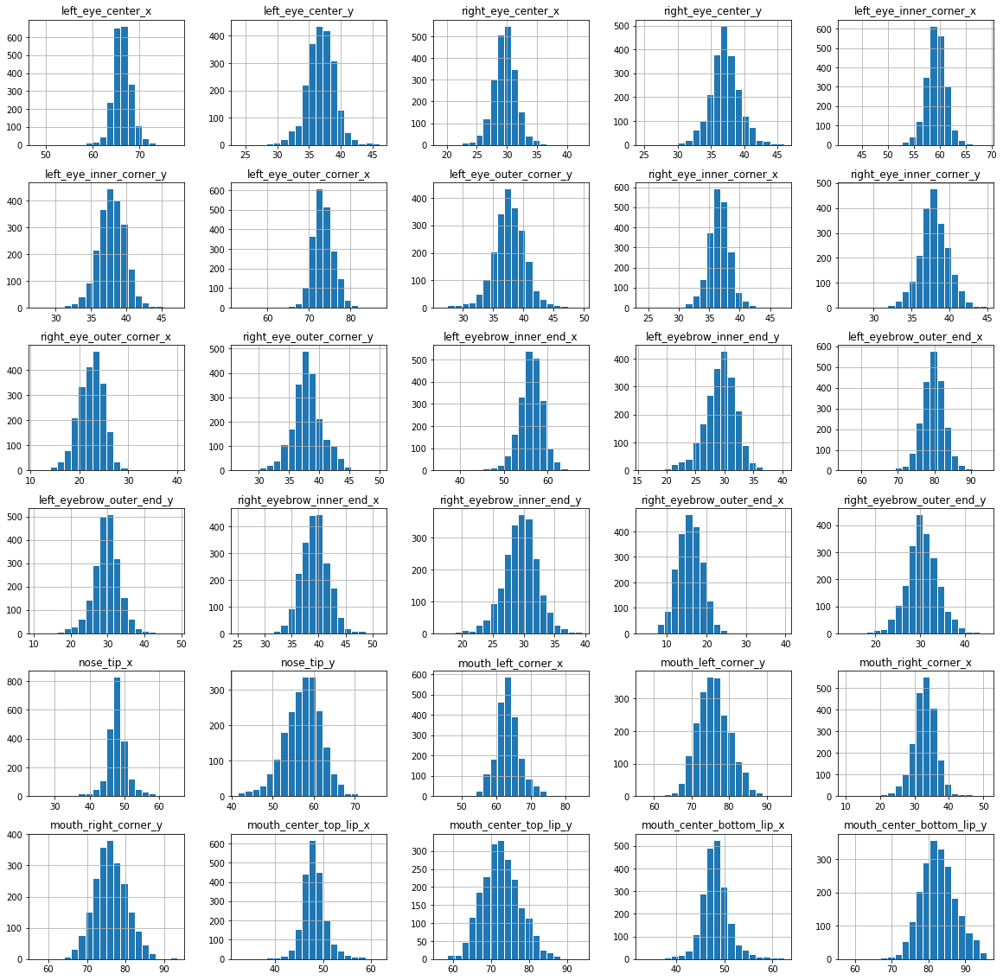
EDA
Distributions of the keypoints (Z scores)
Determine potential outliers/mislabeled facial key points
0.8 train data - 0.2 validation data
Notes:
Coordinating execution, Outliers found using Z scores:
Glasses
Facial Hair/Long Hair
Face tilt

Slide 6
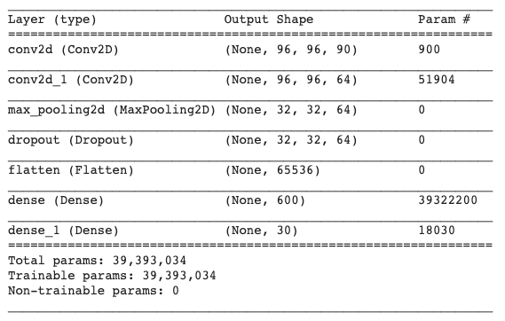
Baseline Model
The initial baseline model architecture and hyperparameters:
2 convolutional layers
1 max pooling layer
1 dropout layer
2 dense layers
The total number of parameters for the baseline model is 39,393,034.

Slide 7
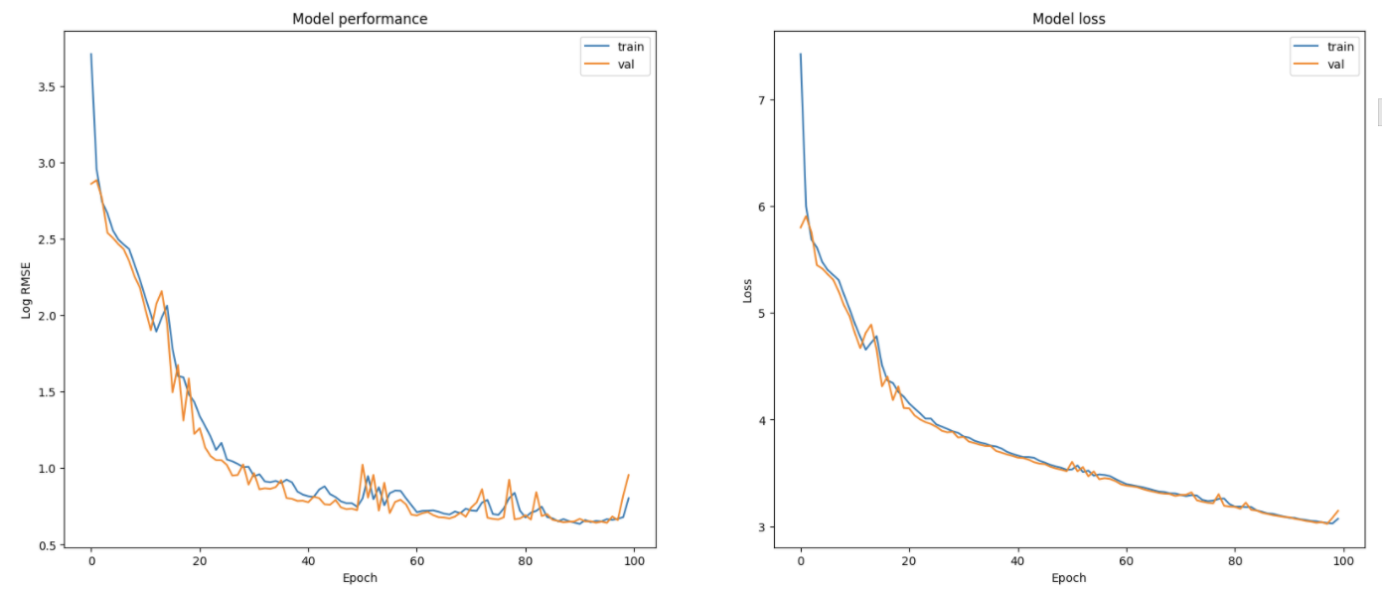
Baseline Model
Notes:
Room for more Epochs, can reduce the loss function more. Train Validation
2.2323 2.5993

Slide 8
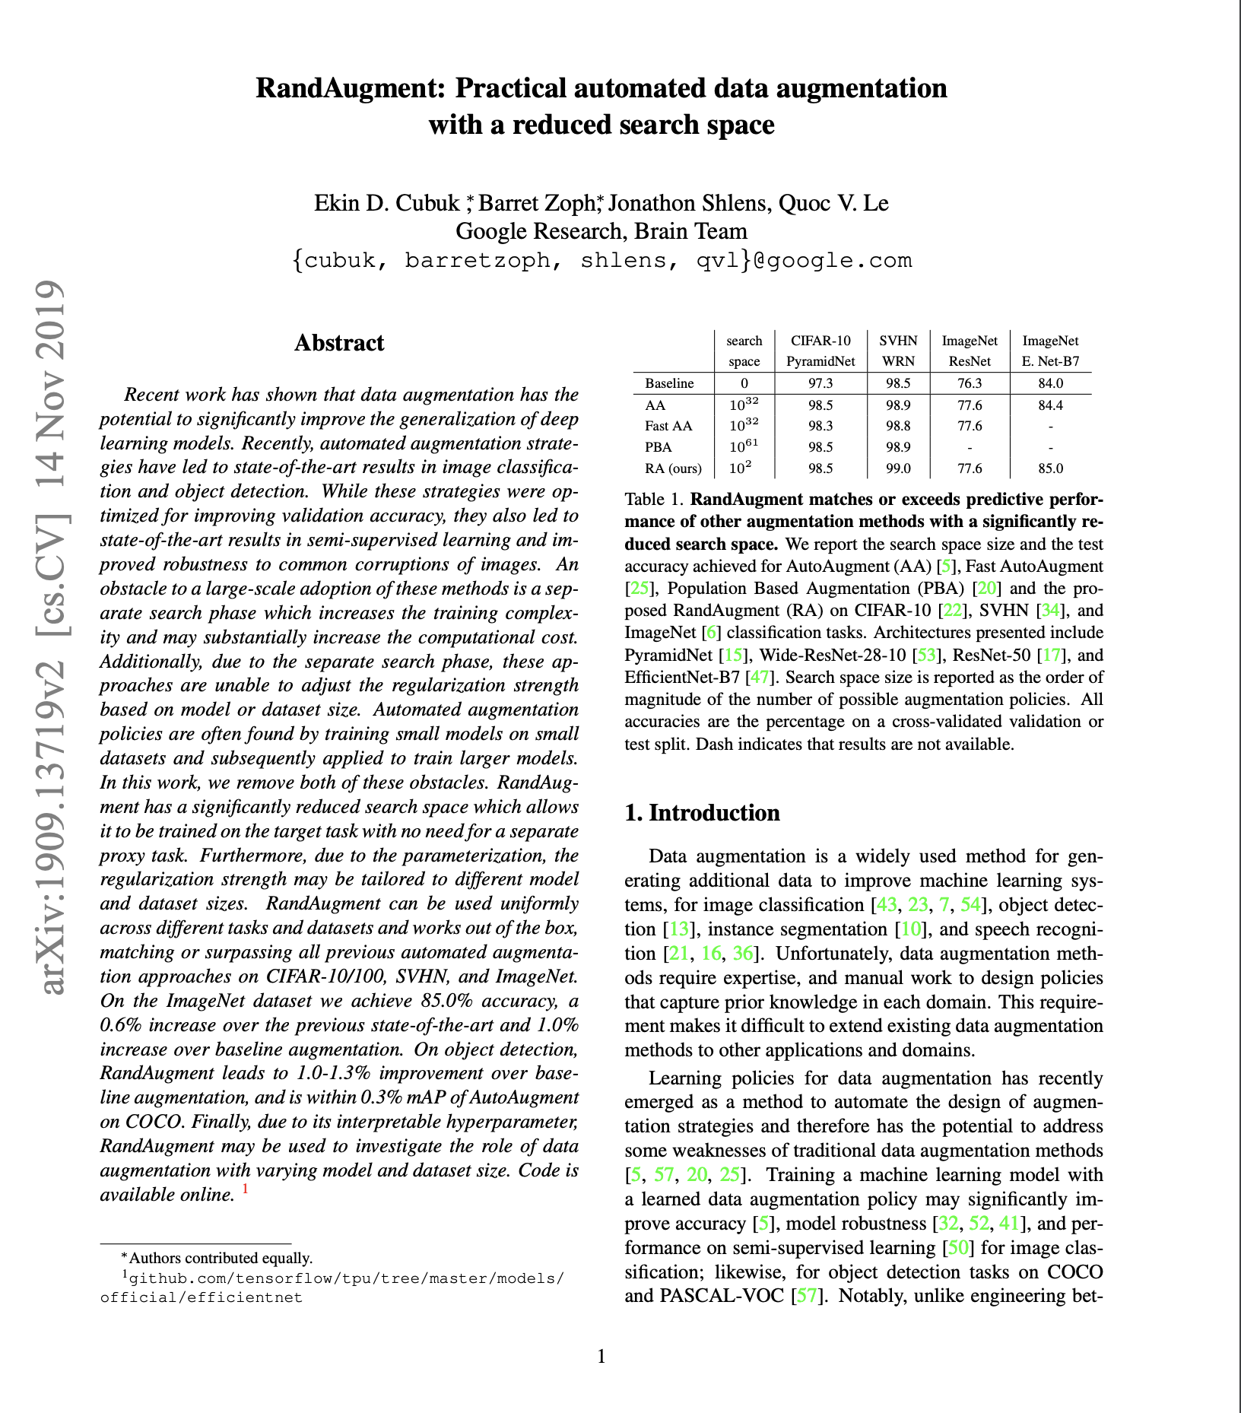
Data Augmentation
Random Augmentation Strategy (RandAug)
Significantly reduces search space
With parametrization, regularization strength can be tailored to different data & models
Works out of the box
Interpretable hyperparameter
https://arxiv.org/pdf/1909.13719.pdf

Slide 9
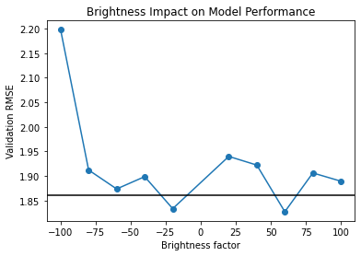
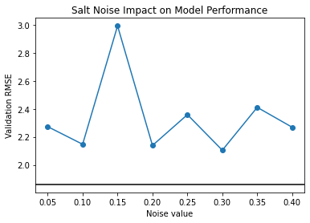
Data Augmentation
Random Augmentation Strategy (RandAug)
Rotation, XY-Flip,
Contrast, Brightness,
Salt-Pepper Noise, Gaussian Noise,
Gaussian Blur
The impact of each augmentation on the baseline model was evaluated
Determine augmentation magnitude

Slide 10
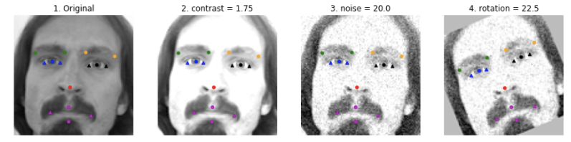
Data Augmentation
Random Augmentation Strategy (RandAug)
Randomly selects N augmentations to be performed on the data.
Each augmentation has a 1/K probability of being selected
An magnitude of M is applied for each augmentation operation. (M is on a scale of 1 to 10)
RandAug parameters of N = 2, M = 2
Led to best improvement on baseline model performance
Was applied for further model training
Notes:
Found that using the CV2 package for augmentation was actual less performant in our cases than writing our own functions from scratch (rotation, contrast especially)

Slide 11
Performance & Results
Model 4a
4 Cov layers, 2 dense layers
Remove pooling layer (increased stride size)
Added batch normalization
Decrease number of nodes in dense layer
Other hyperparameter tuning

Slide 12
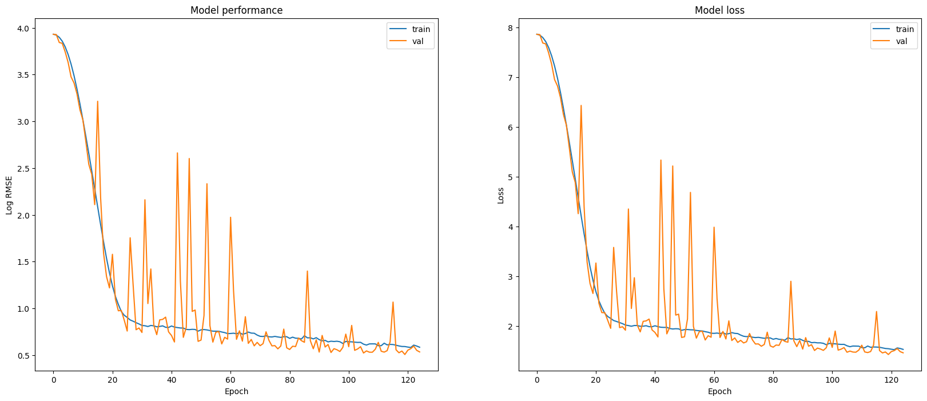
Model 4a

Slide 13
Performance & Results
Model 4a
4 Cov layers, 2 dense layers
Remove pooling layer (increased stride size)
Added batch normalization
Decrease number of nodes in dense layer
Other hyperparameter tuning
Model 4b
Same architecture as Model 4a
Tuned training parameters (increase batch size, increase epochs, increase validation)

Slide 14
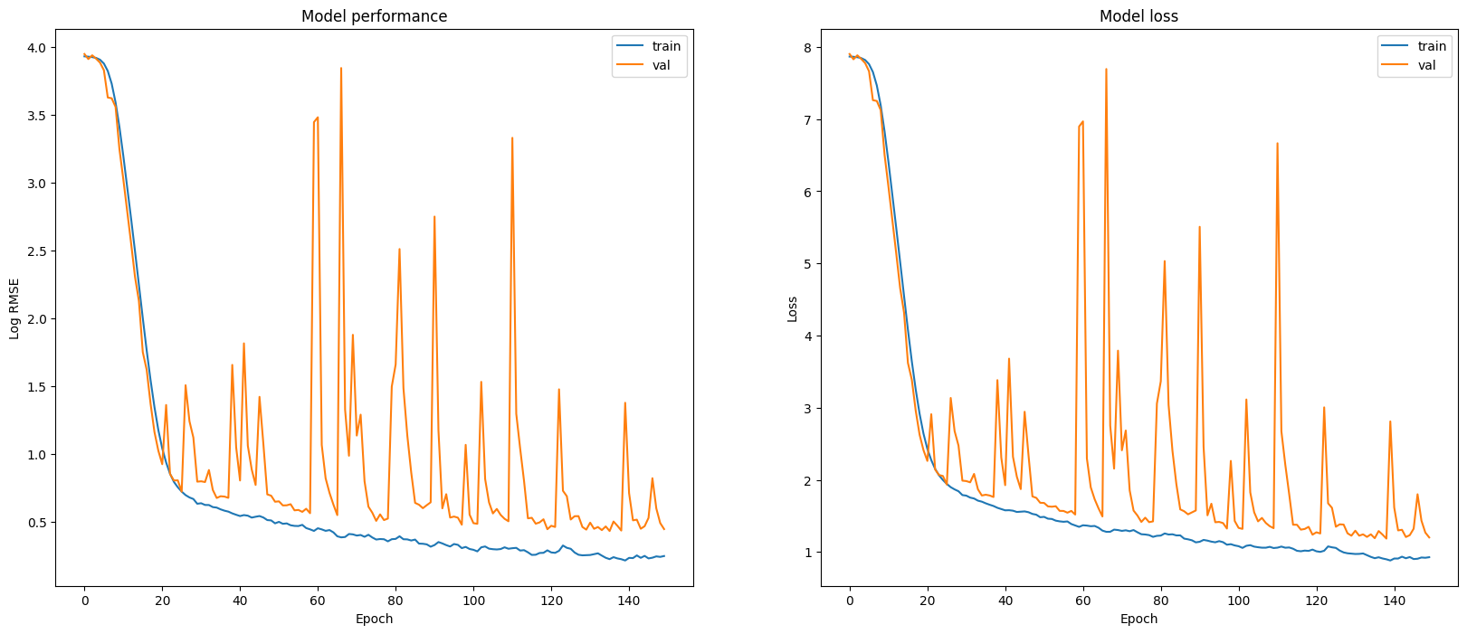
Model 4b

Slide 15
Performance & Results
Model 4a
4 Cov layers, 2 dense layers
Remove pooling layer (increased stride size)
Added batch normalization
Decrease number of nodes in dense layer
Other hyperparameter tuning
Model 4b
Same architecture as Model 4a
Tuned training parameters (increase batch size, increase epochs, increase validation)
Model 5
Decreased width (greater strides, larger window size, less kernels/nodes)
Simpler model (341K weights vs 44M weights)

Slide 16
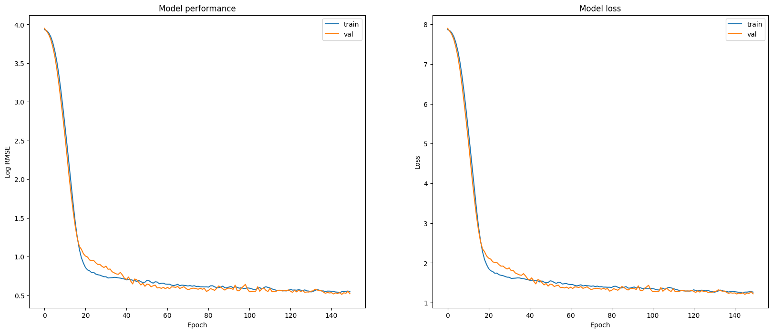
Model 5

Slide 17

Performance & Results
Model 4a
4 Cov layers, 2 dense layers
Remove pooling layer (increased stride size)
Added batch normalization
Decrease number of nodes in dense layer
Other hyperparameter tuning
Model 4b
Same architecture as Model 4a
Tuned training parameters (increase batch size, increase epochs, increase validation)
Model 5
Decreased width (greater strides, larger window size, less kernels/nodes)
Simpler model (341K weights vs 44M weights)
Performance
Model | Train RMSE | Val RMSE
Baseline | 2.1579 | 2.284
Baseline + RandAug | 2.2123 | 1.7849
Model 4a | 1.7839 | 1.7062
Model 4b | 1.2803 | 1.5624
Model 5 | 1.7455 | 1.6824
aggle Test RMSE of 3.1 using Model 4b

Slide 18
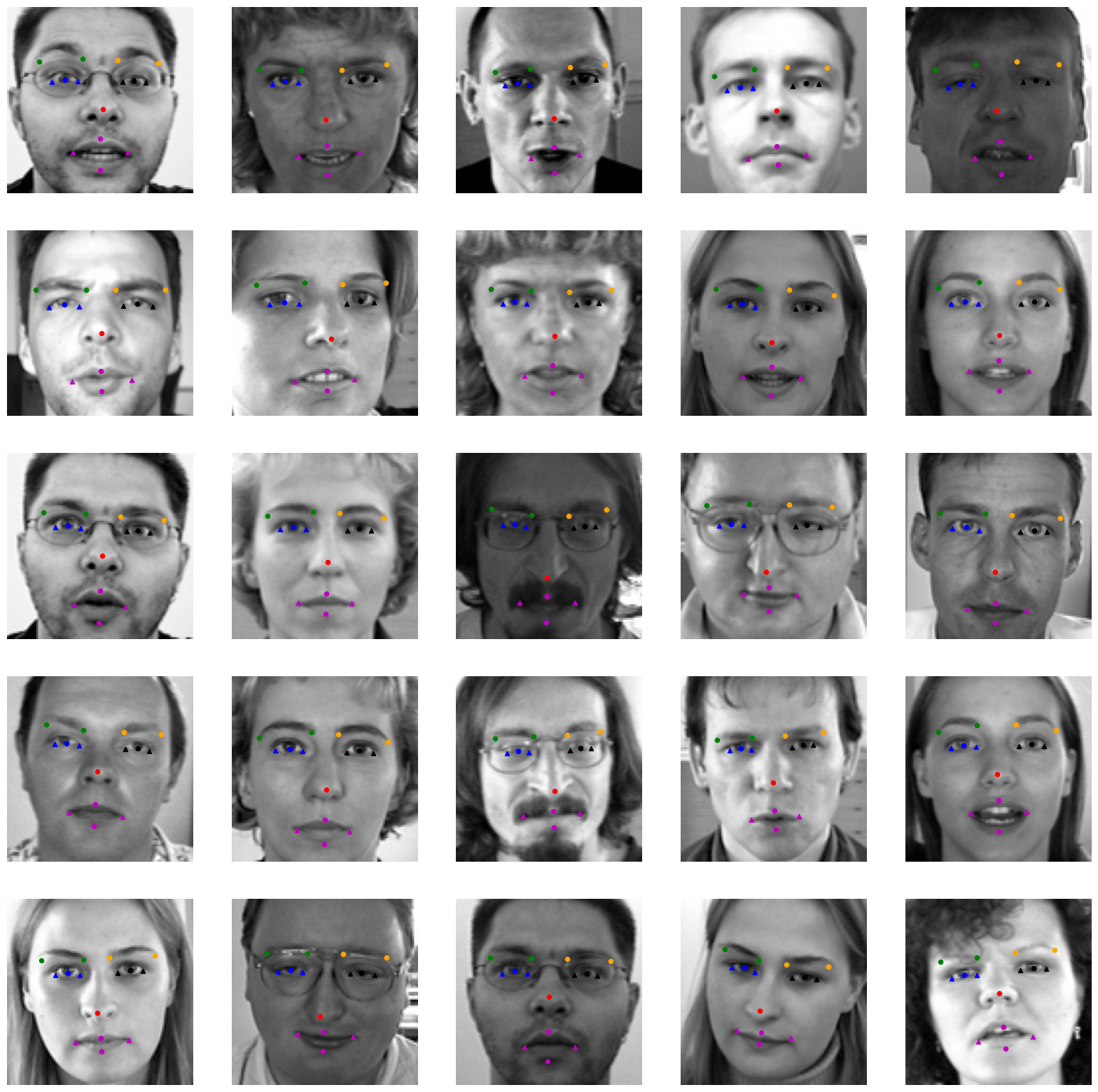
Model 4b - Prediction on Test Set

Slide 19
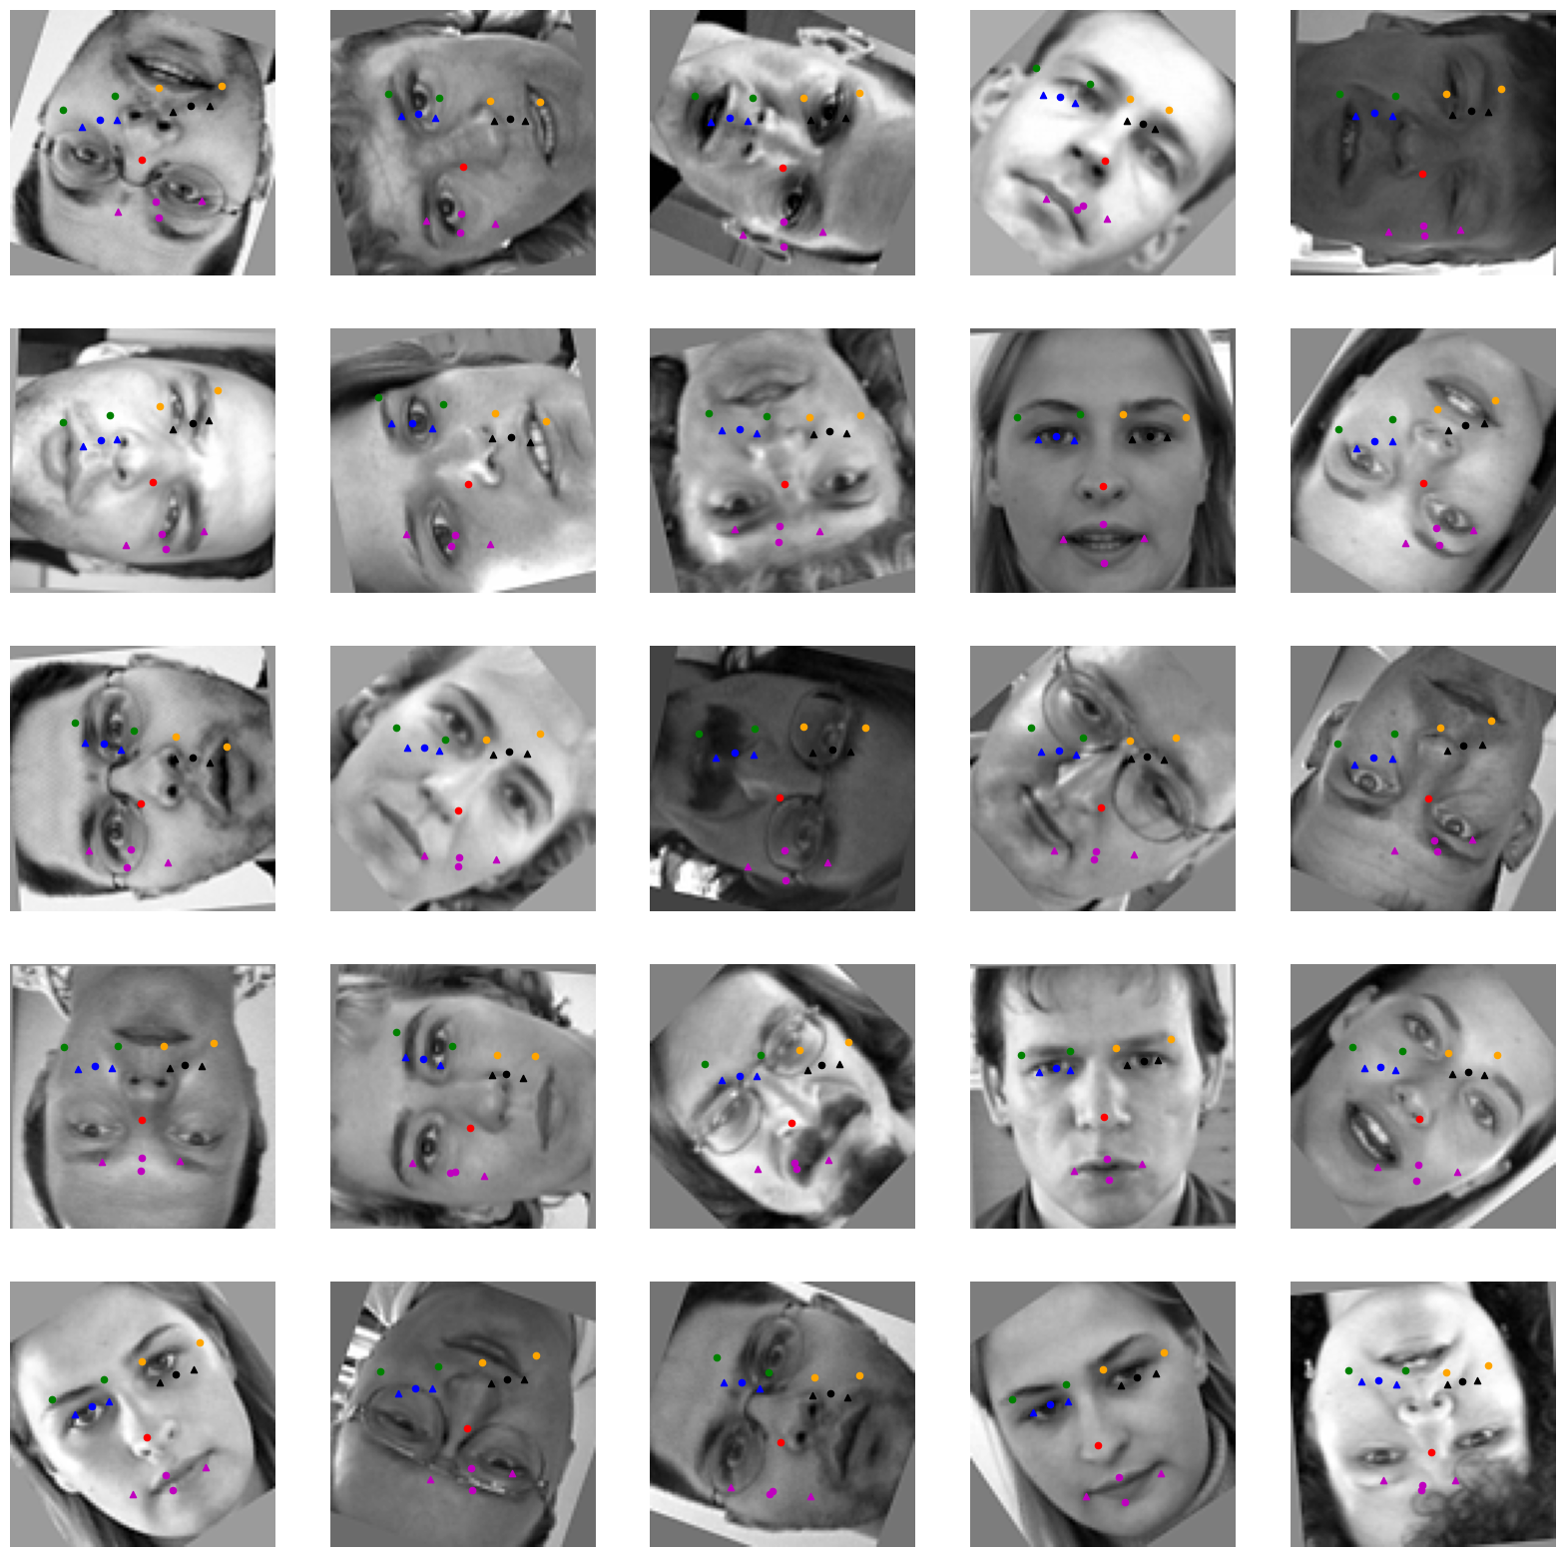
Challenge
Rotated images from original test set
Relatively good performance for minor rotations
Performs poorly on larger degrees of rotation

Slide 20
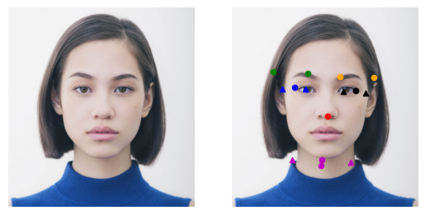
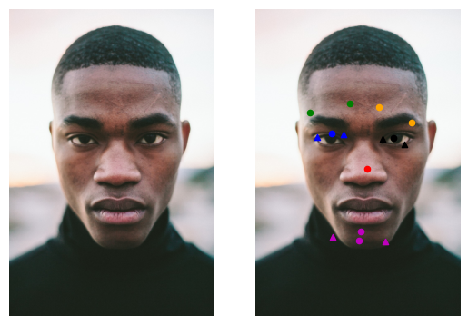
Challenge
Real-life face color images
Model fails to adapt to these images
With faces in different positions
Images are of different scales, compositions, etc.
Notes:
More related to that the head position in the image,
head area ratio over the whole image,
photograph composition from real life image is very variant compared the train data

Slide 21

Lessons Learned
Coordinating execution
Collab, GPU and TPU
Coordinating ops between team
Notes:
Repeat work on same functions
Differing approaches to metrics (absolute values vs. scaled values)
Defining functions in a way that could be all used for randaug

Slide 22
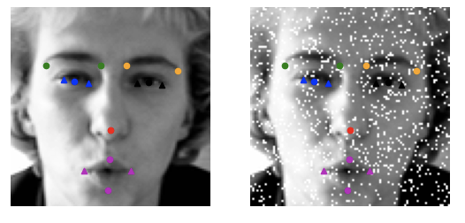
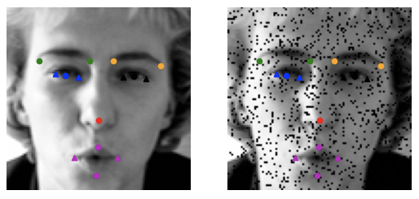
Lessons Learned
Coordinating execution
Data Management + Preprocessing
Small data
Salt & Pepper augmentation
Notes:
Image resolution too low 96x96

Slide 23

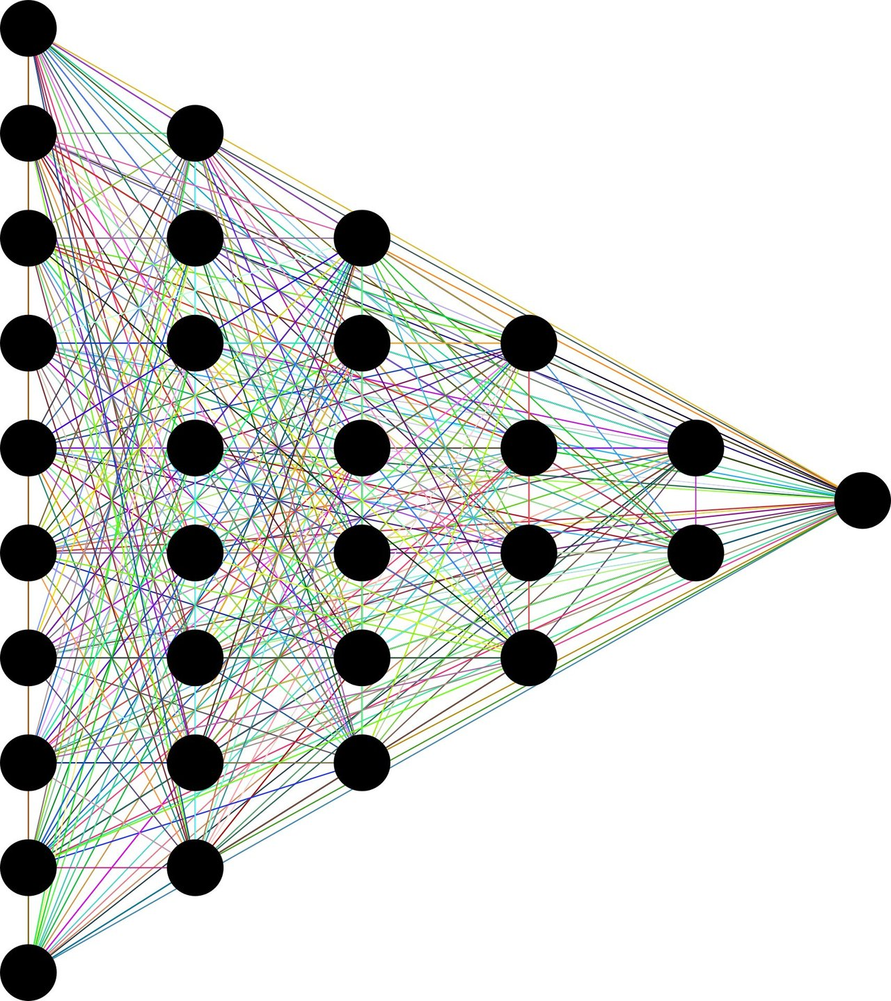
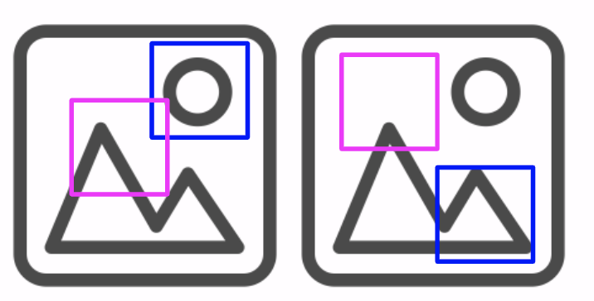
Lessons Learned
Coordinating execution
Data Management + Preprocessing
Model + Tuning
Iterate through model or data
Notes:
Difficult to determine when/order to tune model vs improve data
Getting a good measure of the model performance, (? see comments)
Increasing width (kernels) did little, increasing depth (layers) helped.
Increasing # of params for each layer helped.
Trade-off between model complexity and fluctuations on learning curve
Tough Bias-Variance trade-off
didn’t use cross validation because we didnt want to evaluate on augmented data. Wanted to control for the fact that the augmented data should only be used for training.?
Increasing the width of the model too much (too many kernels) did not lead to any improvement in the baseline accuracy (maybe too complex for the amount of data available to us?)
Instead, focus on making the model deeper (increase number of layers as opposed to increasing num weights per layer)

Slide 24
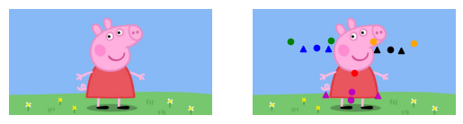
Thank you! Questions?

